Slide 1
WHAT A TIME TO BE ALIVE BY RUMANA HUSAIN Muhammad Hassan Khalid 21L-5692 Muhammad Hamza 21L-5636 Muhammad Ahmad 21L-5617

Slide 2

Detail about the author, his work and the setting
Rumana Husain
Story Name : What a Time to be Alive
Hardships
Covid-19 destroyed her mental health
Setting of story
Psychiatrist Office
Amna visits the office to see psychiatrist and tell him about her mental health

Slide 3
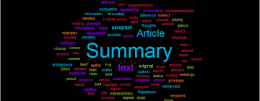

Summary
The story is about a girl Amna who got married without the consent of her parents and later got divorced and lost the custody of her only child. Later she lost her parents in a plane crash. She got depressed and had outbreaks in her friends meetings hence she had to visit a psychiatrist to solve her mental stress. His brother also got Covid-19 and hence had to stay away from her.

Slide 4

Main Idea
Difficulties Amna had to face in her life.
Lost her child and parents.
Covid-19 affected her twin brother.
His health deteriorated.
Overcome her depression of losing her child to her divorced husband.
Seeing a psychiatrist.
Letting out her emotions.
Outbursts with her friends.
Affecting her social life.

Slide 5

Tone
Tone is Depressing
Sad moments
Have an emotional response
“She had filed for divorce some years later after the man she had eloped with, fell in love with another woman. During the acrimonious divorce proceedings, Amna lost custody of her only child.”
Heart-wrenching sentence
Painful to read

Slide 6

Pattern of Organization
Chronological pattern
Time wise manner
Amna disobeys her parents commands
Marries a person
Loses the custody of her child
Parents die in a plane crash
Brother becomes a target of Covid-19
Points are happening in a timely manner one after another

Slide 7
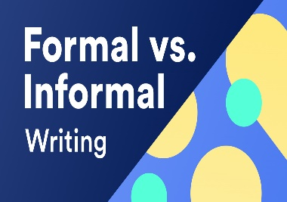



Purpose of the author
Entertain the readers
Personal life experience
Saddening story of her life
Problems she had to suffer in that time period
Main purpose of the author was to entertain the readers
Style : Informal Style
Appeals : Pathos
Negative and Positive Points : Good Punctuation and Vocabulary
Topic relevance : Topic relevant to young generation
Achievement of purpose : Purpose Fully Achieved

Slide 8

Opinion
Day-by-day increasing problem of covid-19
Losing their close ones
State of depression
Share their feelings with others
Socialize in this hard period
Respect the orders of elderly
Challenges
Stay positive
Help each other in this pandemic

Slide 9

Summary of the analysis
Purpose was to entertain
Informal way
Chronological pattern
Depressing tone
Story is well-written
Highly relevant to today’s young generation
Interesting and attention-grasping vocabulary
Appeal was pathos
Fully achieved his purpose
Covering all positive points

Slide 10




CONCLUSION
Distressing times in her life
Disclosing the big secret
Huge load being lifted from her shoulders
New chapter in her life

